Slide 1
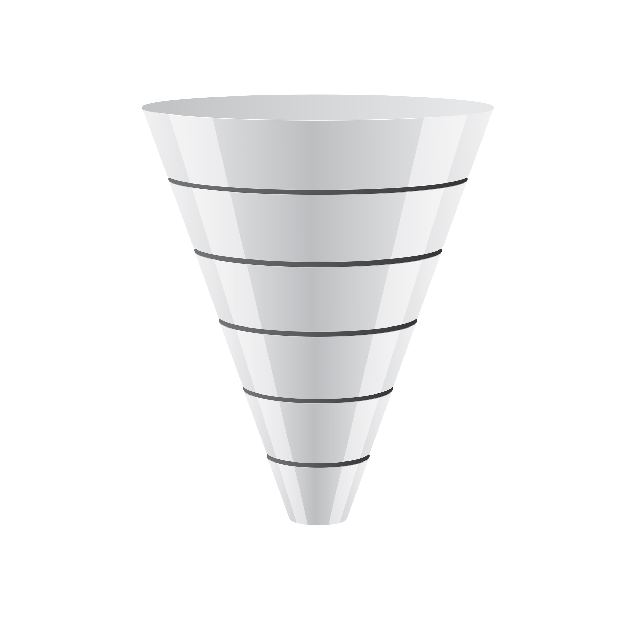
Sales
&
Growth
Patient Sales Process
Grow Clinical Referral Network
Grow
Discovery
Results
Visit Clinic
Laser Advanced
HILT Solution
Word of Mouth
Evaluation
Treatment
Educate Clinicians
Value
Provide Treatment
Sale
Invest in HILT
Notes:
Talking Points
Once big circle that pick up the value/ sales & identify & grow = 2 interrelated circles
Eliminate sales funnel multi-steps = referral process/ business

